Slide 1
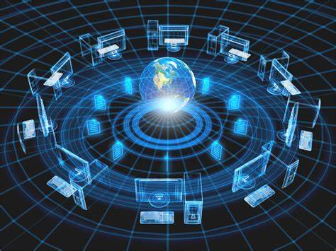
INTERNET SERVICES
The Internet is the global system of interconnected computer networks that uses the Internet protocol suite to communicate between networks and devices. It is a network of networks that consists of private, public, academic, business, and government networks of local to global scope, linked by a broad array of electronic, wireless, and optical networking technologies.

Slide 2
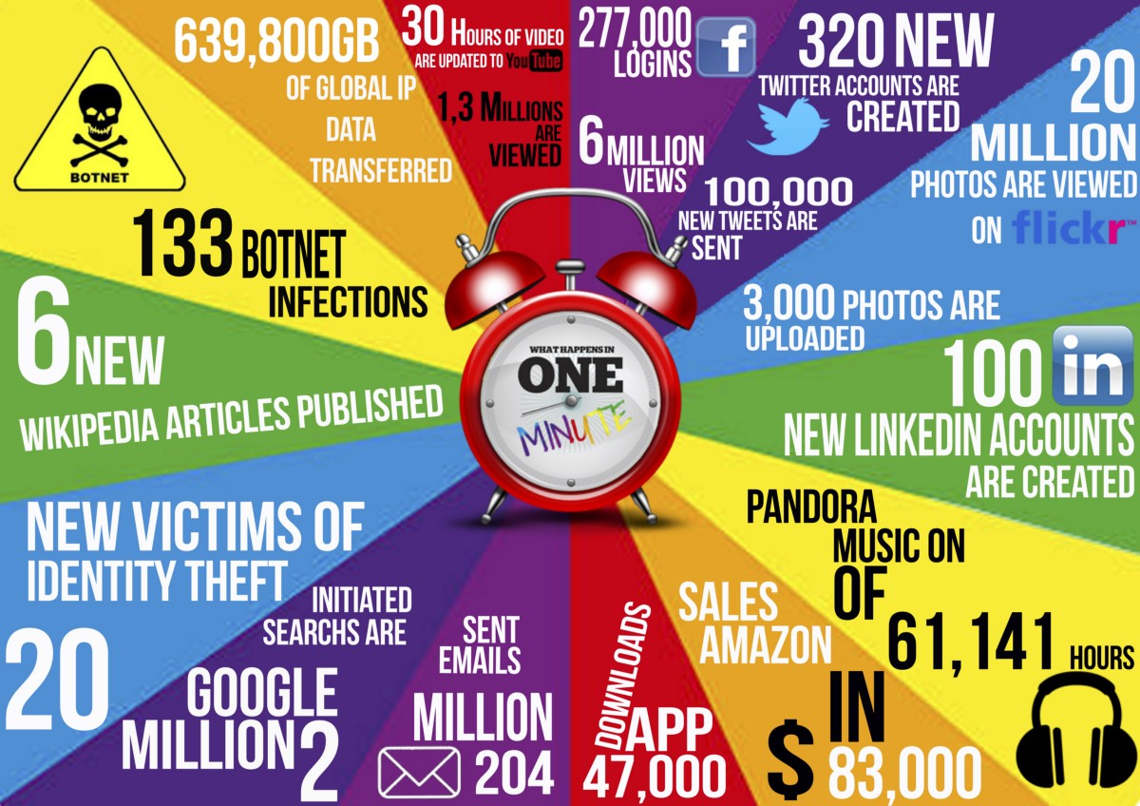

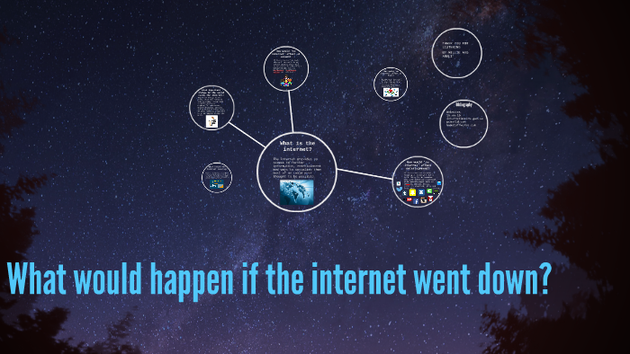
IF INTER WOULD NOT BE THERE WHAT WOULD HAPPEN ?
If internet stopped working many things got stopped like many people work from home , children’s online classes as many more things , access between airports, planes, ships, trains, and commercial trucking, we’d go back to tracking goods on paper. This would raise the market value of transported products, as it would be more complicated to deliver goods to stores.

Slide 3
Presented by – Sarthak Jain, Vaibhavi Yadav , Rudra Pratap Singh and Samarth Shivheare

